Slide 1


Shelter Animal Outcomes
IST 652 – Scripting for data analysis
Brandon croarkin

Slide 2
Data Pipeline
Obtaining the data
Cleaning the data
Exploratory data analysis (EDA)
Feature Engineering
Model Building
Interpretation

Slide 3
Data
Kaggle – from the Austin Animal Center from October 1st, 2013 to March, 2016
https://www.kaggle.com/c/shelter-animal-outcomes/data
BLS – Austin-Round Rock, TX Total Nonfarm employment, in thousands
https://www.bls.gov/bls/proghome.htm#employment

Slide 4
Data Fields
DateTime
OutcomeType
OutcomeSubtype
AnimalType
Breed
Color
Neutered
Gender
Age
Employment

Slide 5
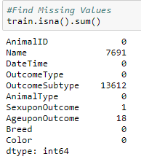
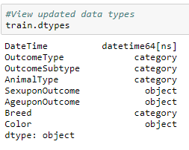
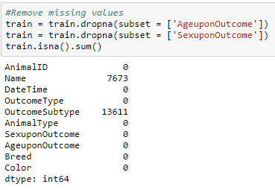
Data Cleaning
Converted data types for proper analysis
Removed missing data

Slide 6
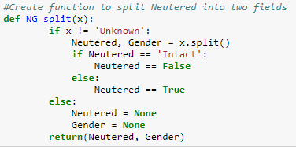
Feature Engineering
Neutered → Neutered & Gender field
Original Form = “Spayed Female”, “Neutered Male”, “Intact Male”, etc.
New Form = (“Neutered”, “Female”), (“Neutered”, “Male”), (“Intact”, “Male”)

Slide 7
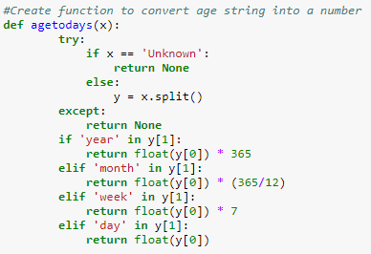
Feature Engineering
AgeuponOutcome → Age
Original Form = “1 year”, “3 weeks”, “6 days”, etc.
New Form = 365.0, 21.0, 6.0

Slide 8
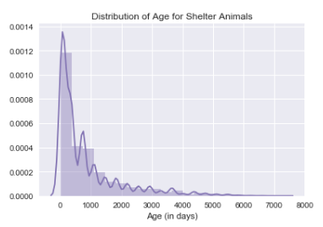
Analysis: Distribution of ages for shelter animals
Mean: 2.2 years old (819 days)
Median: 1 year old (365 days)

Slide 9
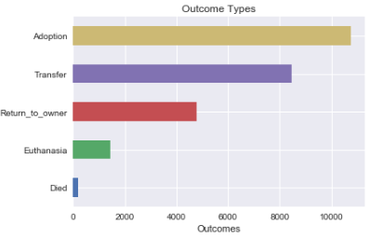

Analysis: What are the different outcome types for shelter animals and their frequency?

Slide 10

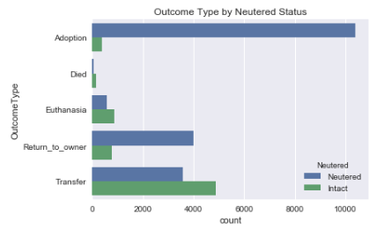



Analysis: Does shelter outcome differed based on neutered status?

Slide 11
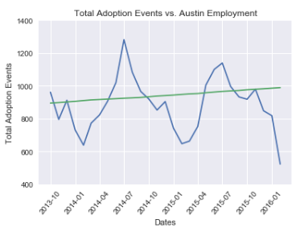
Analysis: Is there a relationship between adoption events and employment in Austin?
Slow, steady increase in Austin employment over time
Cyclical nature to adoption events (includes all outcome types)
Appears to be slight increase in total adoption events over time, although there is a drop-off at end of chart

Slide 12
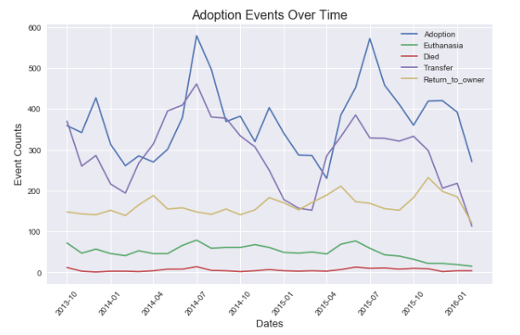
Analysis: Is there a trend in adoption events over time?
There is a drop in Euthanasia that occurs around June 2016
There is a clear seasonal nature to adoption, with adoptions spiking in July

Slide 13
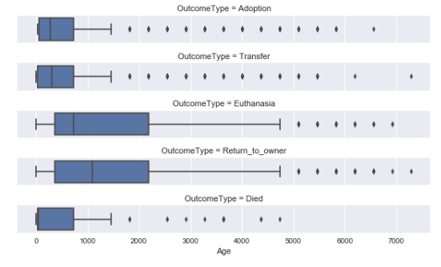
Analysis: How do outcomes differ across animal ages?
- There is a clear difference in animal ages for those that are euthanized and returned to owner, with the mean age and spread of ages being much larger.
- The low mean age of animals that died indicate that these are random events that would be hard to predict

Slide 14
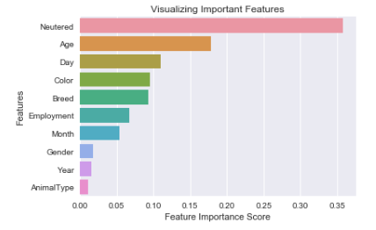
Predictive Analytics: How accurately can an animal’s adoption status be predicted?
After just focusing on ‘Adoption’ vs. ‘Euthanasia’ the ability of the random forest model to predict the outcome with 93% accuracy!
Most important features:

Slide 15
Questions
???

